Slide 1

LET IT SNOW IN THE SUMMER!
SNOWFLAKE WITH SQL SERVER GUY’S EYES
PAWEŁ POTASIŃSKI | SEPTEMBER 2019

Slide 2


SPEAKER
CTO @ Elitmind (Snowflake’s partner)
Founder of PLSSUG (now DC.pl)
Microsoft Data Platform MVP
(Big) Data & Cloud Enthusiast
Blogger (http://blog.sqlgeek.pl)
Family man
Runner

Slide 3
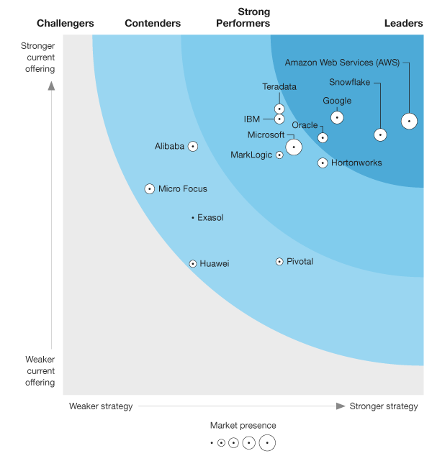
WHY THIS SESSION?
Forrester positions Snowflake as a strong leader of cloud data warehousing.
https://reprints.forrester.com/#/assets/2/241/RES141572/reports

Slide 4
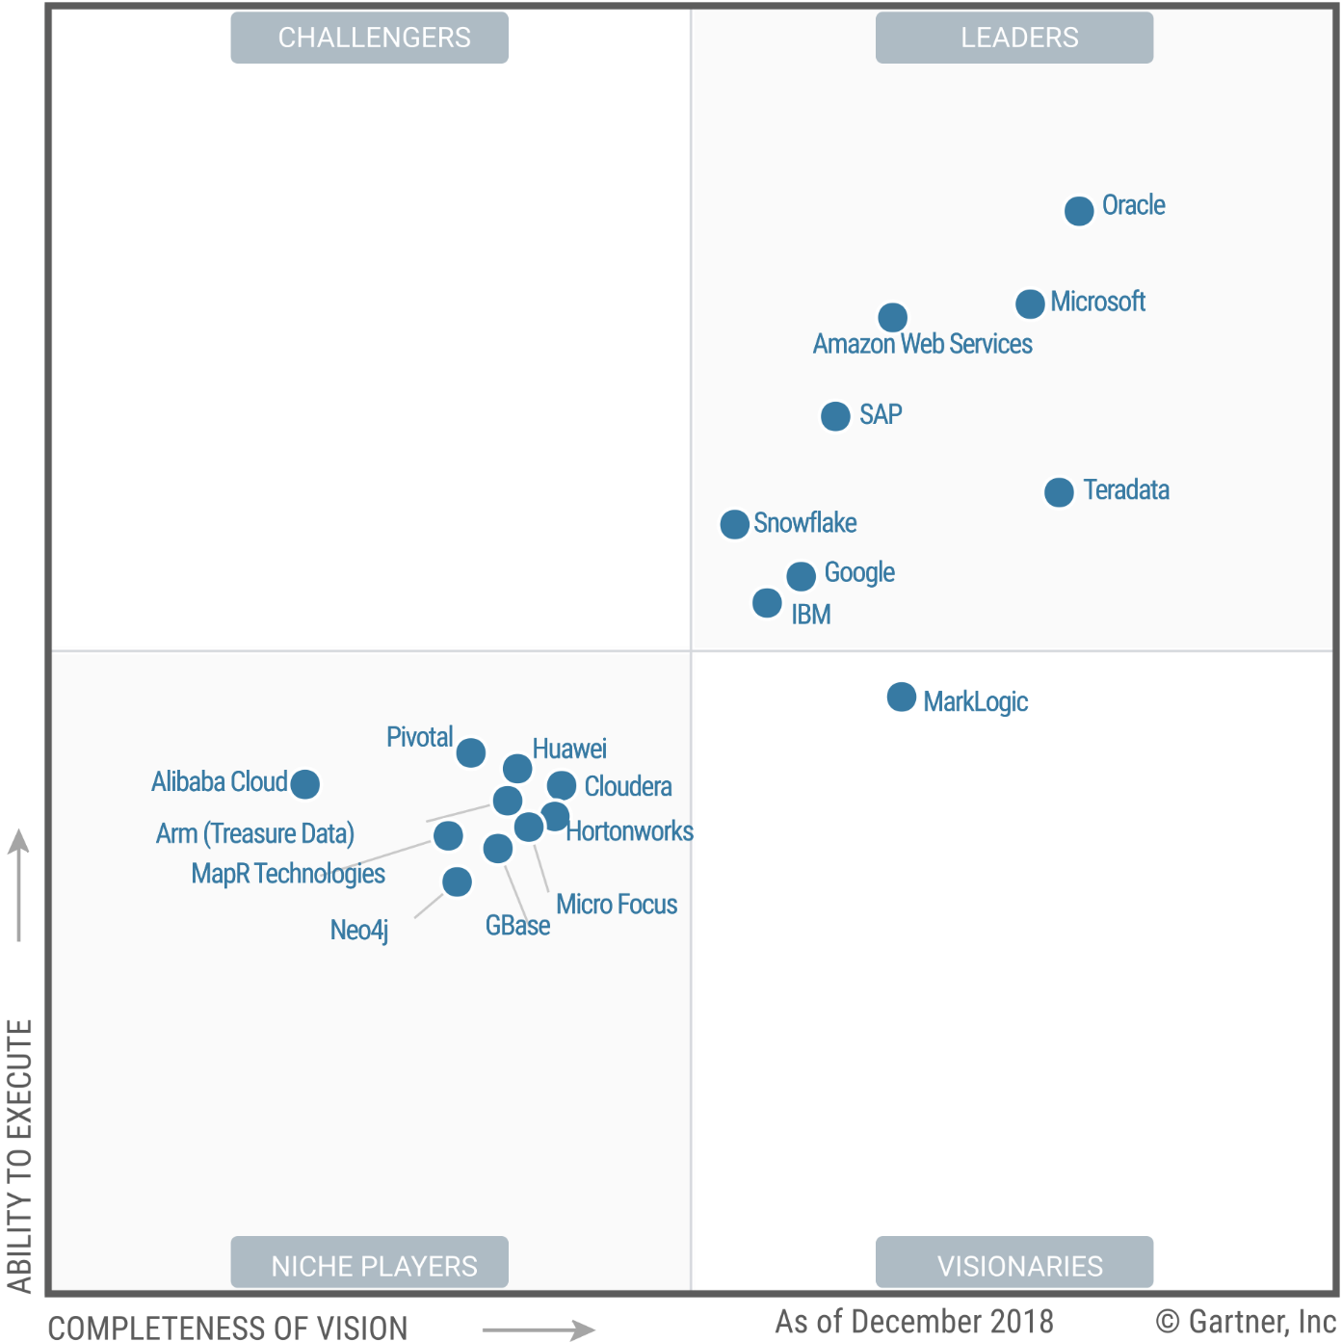
WHY THIS SESSION?
Snowflake named a leader of DMSA market by Gartner.
https://www.gartner.com/doc/reprints?id=1-65YF38P&ct=190128&st=sb

Slide 5

DISCLAIMER
Official Snowflake slides will be shown
This is not a sponsored session
Subjective opinions will be shared
Snowflake on Azure ONLY
This session is NOT about data warehousing methodologies

Slide 6
AGENDA
Key Concepts and Architecture
Loading Data into Snowflake
Snowflake’s Unique Features
SQL Surface
Cost Management
Editions & Pricing
How to Learn Snowflake

Slide 7
CURRENT PROBLEM
Siloed, Diverse
Data
Scale and Speed Issues
Complex, Costly Infrastructure
Slow, Limited
Decision Making
Many data sources/stores
Semi-structured data
Cannot easily share
Cannot scale up/out easily
Slow queries & ingest
Resource contention
Costly software & hardware
Over-provisioned
Lots of maintenance/ tuning
Many languages
Limited queries & users
Data is stale & incomplete
Cannot optimize revenue & costs

Slide 8
SNOWFLAKE SOLUTION
Unique architecture built for the cloud
All data centralized,
shareable
Unlimited, automatic scale and speed
Simple, cost effective infrastructure
Faster, better
decision making
All data, structured and semi-structured
Single source of truth
Securely share live data with partners
Separation of storage & compute
All workloads get proper, isolated resources
Handles spikes
No hardware
Fast time to value
Less maintenance
Pay as you use
Complete SQL
Unlimited queries & users
Fresh and complete data
Optimize revenue & costs

Slide 9

LEGACY ARCHITECTURE (BEFORE)
Data Sources
BI / Analytics
ETL
EDW
Datamarts
Marketing
OLTP Databases
Enterprise Applications
Finance
Third-Party
Externals
Test/Dev
Web / Log Data
Data Science
Other
Data Lake / Hadoop

Slide 10
MODERN ARCHITECTURE (AFTER)
Data Sources
ETL / ELT / Streaming
BI / Analytics
EDW
Marketing
OLTP Databases
Enterprise Applications
Finance
Third-Party
Externals
Test/Dev
Web / Log Data
Data Science
Other

Slide 11
A NEW ARCHITECTURE FOR DATA WAREHOUSING
Multi-cluster, shared data, in the cloud
Traditional Architectures
Snowflake
Shared-disk
Shared-nothing
Multi-cluster, shared data
Additional capacity requires forklift upgrade
Reads/Writes at the same time cripples the system
Replication requires additional hardware
Resizing cluster requires redistributing data. Shut down requires unloading.
Each cluster requires its own copy of data (ex: test/dev, HA)
Vacuuming processes needed to maintain sort and distribution for performance
Centralized, scale-out storage that expands and contracts automatically
Independent compute clusters can read/write at the same time and resize instantly
Automated backup across multiple availability zones (regions in October)

Slide 12




SNOWFLAKE ARCHITECTURE
User Interface
VPC / VNET
ODBC Driver
JDBC Driver
Web UI
Compute EC2 / VM
XL
y
y
L
y
y
L
y
y
y
y
y
y
Cloud services
Customer Reports
Campaign Analysis
Loading WH
Optimization
Query Management
Warehouse Management
Security
L
C
2
S
H
W
1
T
3
6
V
8
P
Q
R
S
4
O
7
DDL
Q
K
9
B
U
D
F
T
U
V
W
G
Nodes
Nodes
Metadata
Metadata
Metadata
P
J
8
3
Source Data
Campaign Analysis
Loading WH
Enterprise Data
Online Data
F
6
B
R
1
Nodes
Customer Reports
Storage S3 / Azure Blob
1
2
3
4
5
6
7
8
P
Q
R
S
9
A
B
C
D
E
F
G
T
U
V
W
H
I
J
K
L
M
N
O

Slide 13
SNOWFLAKE ARCHITECTURE
User Interface
VPC / VNET
ODBC Driver
JDBC Driver
Web UI
Compute EC2 / VM
L
(Multi-cluster Warehouse)
Campaign Analysis
Cloud services
Optimization
Query Management
Warehouse Management
Security
W
T
6
V
H
W
1
T
3
6
V
8
P
Q
R
S
9
B
7
DDL
U
F
9
B
U
D
F
T
U
V
W
Nodes
Nodes
Nodes
Metadata
Metadata
Metadata
Source Data
Enterprise Data
Online Data
Storage S3 / Azure Blob
1
2
3
4
5
6
7
8
P
Q
R
S
9
A
B
C
D
E
F
G
T
U
V
W
H
I
J
K
L
M
N
O

Slide 14

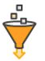








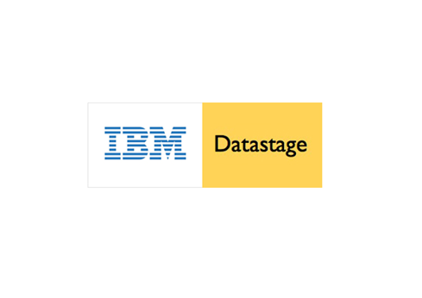






























AWS Glue
L
AWS QuickSight
ETL/ELT
Sales
XS
M
Snowpipe
S
S
Global Services
Data Science
Logical Model
Security
Query Planning & Optimisation
M
Transactional Control

Slide 15
AWS Glue
AWS QuickSight
ETL/ELT
Sales
XS
M
…
M
Multi-cluster
Snowpipe
XL
S
Global Services
Data Science
Logical Model
Security
Query Planning & Optimisation
Transactional Control

Slide 16
DEMO 01
Key Concepts and Architecture
Snowflake’s Tools

Slide 17
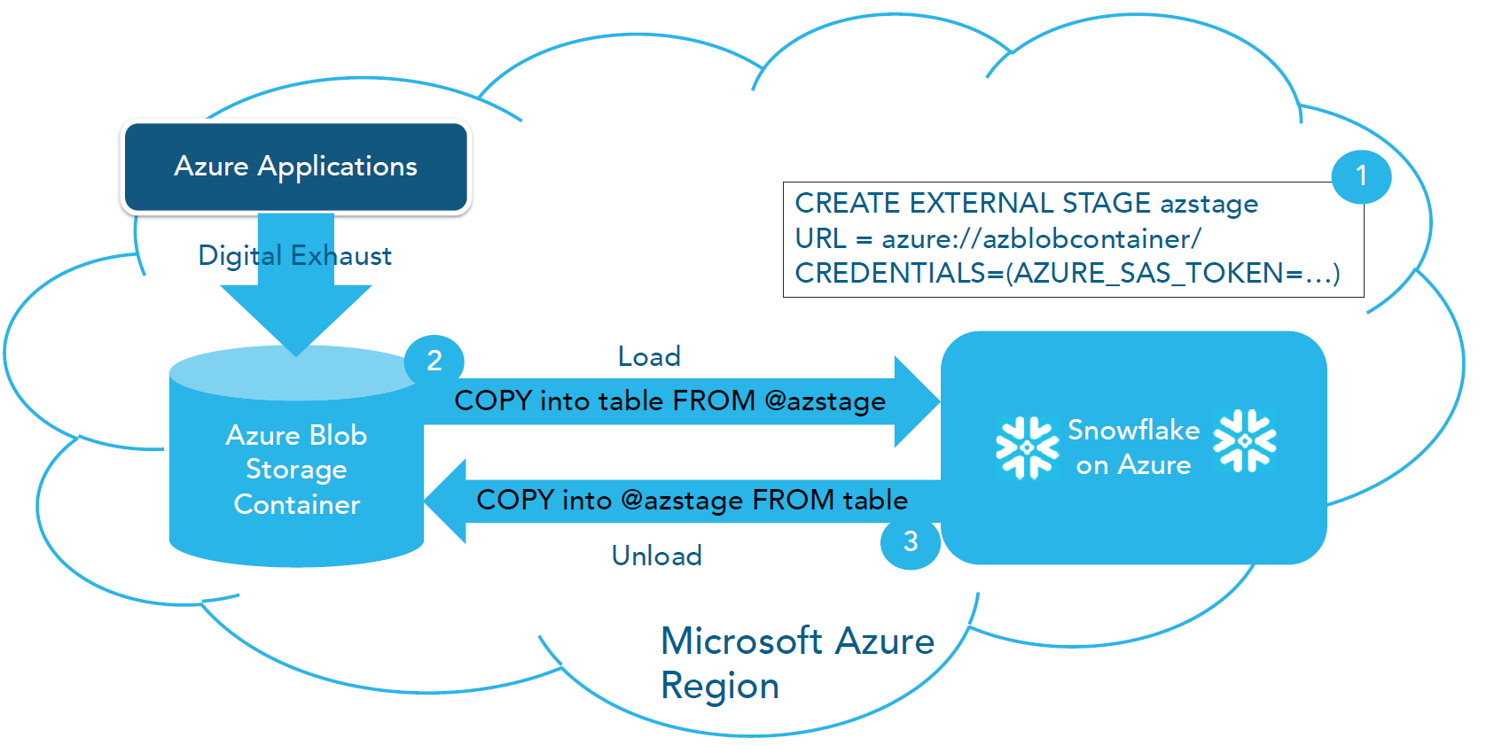
SNOWFLAKE AZURE DATA ACCESS

Slide 18









STREAMING ANALYTICS
WITH SNOWFLAKE ON AZURE
Structured data
Line of Business
Azure Databricks
Azure HDInsight
Azure Data Factory
Data Science
Notebooks
CRM
Spark Connector
On-Premises
Databases
Azure Stream Analytics
Snowpipe
Data Gateway
Azure Blob Storage
Azure Data Lake Storage
Power BI
Snowflake on Azure
ODBC Connector
Unstructured data
Spark Streaming
Cloud Data
Azure Event Hub
Azure IoT Hub
IoT
Telemetry
Power BI
(Desktop)
Social Data
Kafka on HDInsight

Slide 19
DEMO 02
Batch Loading with Stage
Continous Loading with Snowpipe

Slide 20










AWS Glue
External
AWS QuickSight
M
ETL/ELT
Sales
XS
Data Sharing
M
…
M
Multi-cluster
Snowpipe
Structured & semi-structured
Clone
S
XL
XL
Data protection & time travel
Global Services
Dev Ops
Data Science
Logical Model
Security
Query Planning & Optimisation
L
Transactional Control
Finance/DBAs

Slide 21
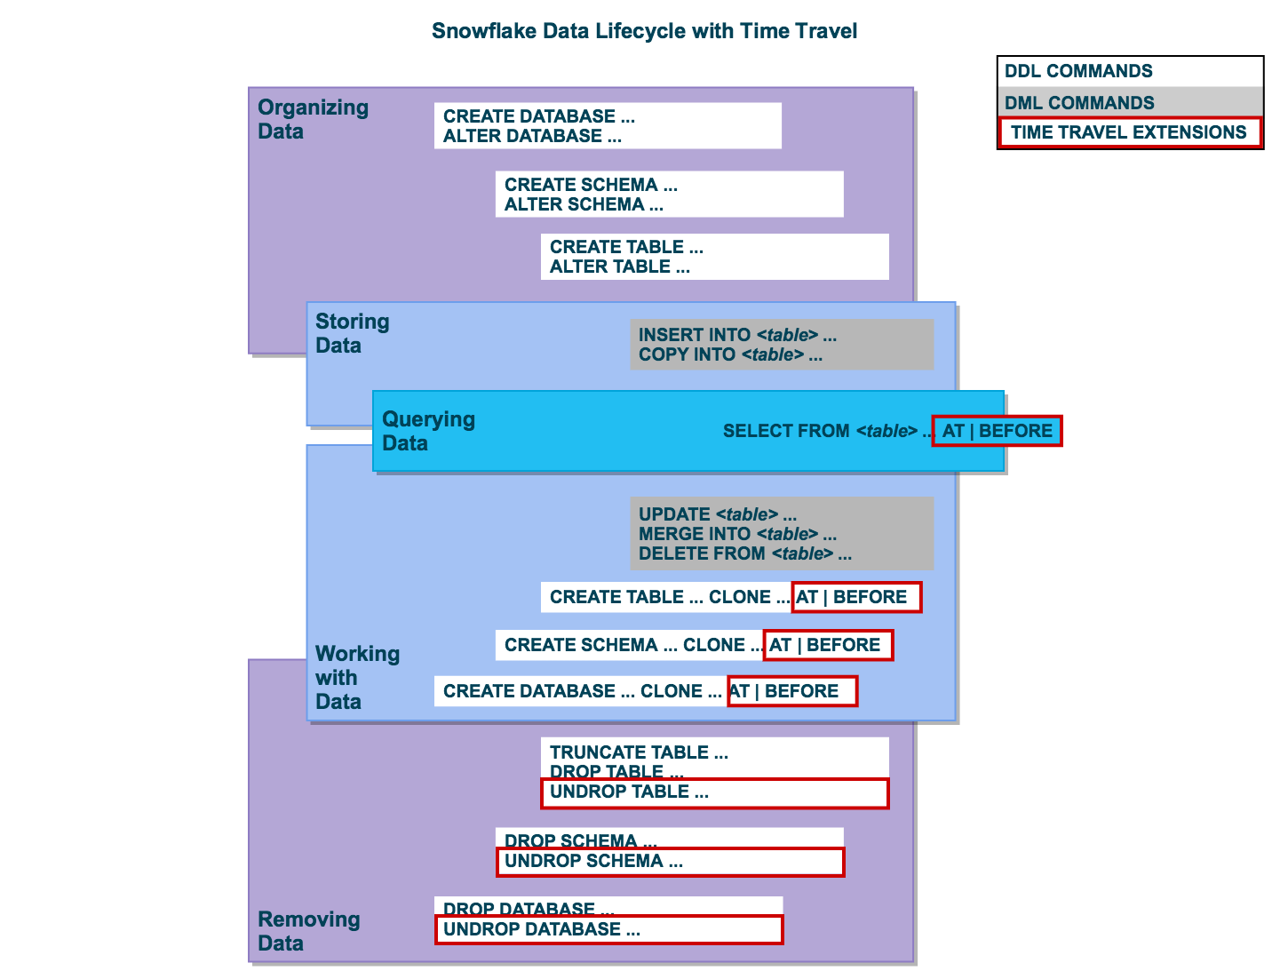
TIME TRAVEL
Access to historical data
No configuration required
Scenarios:
Query data in the past
Create clones
Restore tables & databases
SQL extensions
CREATE...CLONE
UNDROP
Time related parameters
TIMESTAMP
OFFSET
STATEMENT

Slide 22
SEMI-STRUCTURED DATA
Multiple supported formats
JSON, XML, ORC, AVRO, Parquet
VARIANT data type
Max size 16 MB (compressed)
FLATTEN function
LATERAL JOIN
SELECT src:device_type::string , src:version::string , value
FROM raw_source , LATERAL FLATTEN( input => src:events );

Slide 23
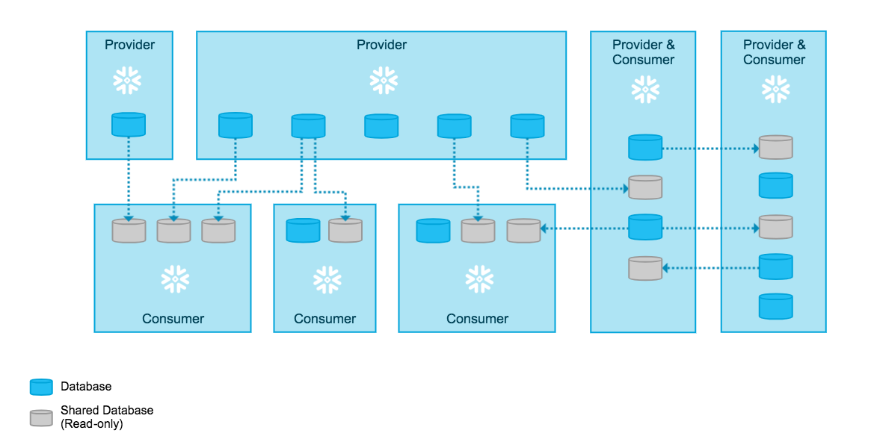
SECURE DATA SHARING

Slide 24
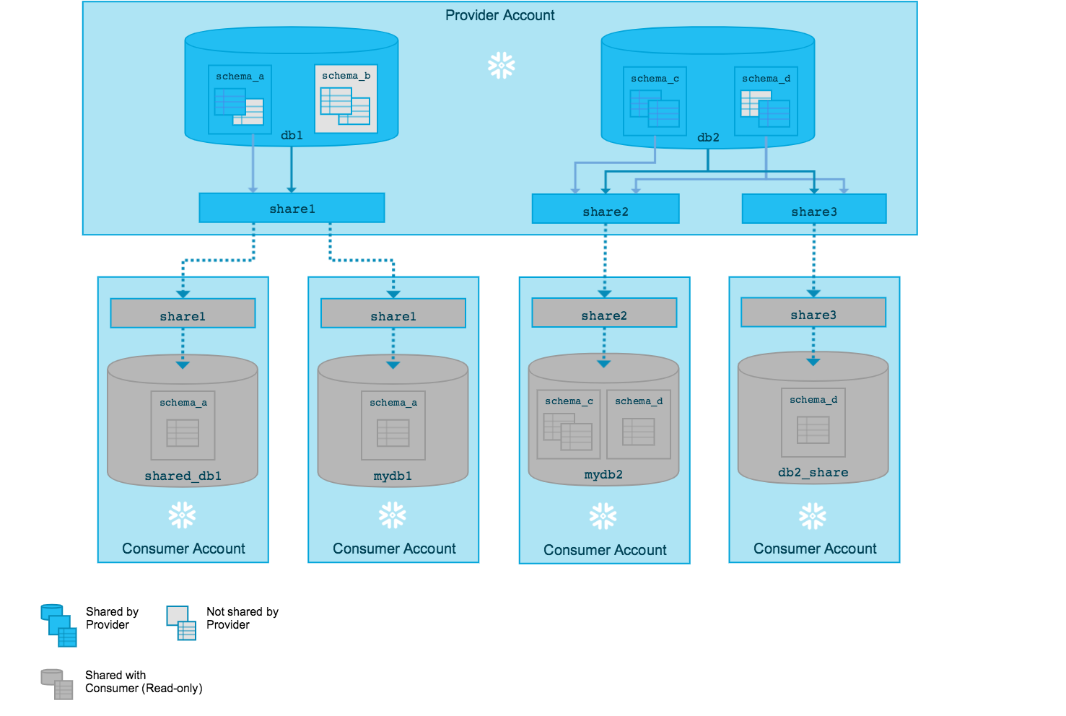
SECURE DATA SHARING

Slide 25

SNOWFLAKE SECURITY
Enterprise
Snowflake Operational Controls
NIST 800-53
SOC2 Type 2
Access
All communication secured & encrypted
TLS 1.2 encryption
IP Whitelisting
Authentication
Password Policy enforcement
Multifactor Authentication
Key Pair Authentication
SAML 2.0 support for Federated Authentication
Application
Flexible user management
Role-based access control for granular control
RBAC for data and actions
Data
Encrypted at rest
Hierarchical key model rooted in Cloud HSM
Automatic key rotation & Annual account-level re-keying of data
Time Travel 1-90 days
Fail-Safe
Infrastructure
AWS, Azure Physical Security
AWS, Azure Redundancy
Regional Data Centers
US
EU
AP

Slide 26
DEMO 03
Time Travel & Cloning
Semi-structured Data
Data Sharing

Slide 27
SQL SURFACE
Most DDL and DML defined in SQL:1999
Advanced DML
Multi-table INSERT
Multi-MERGE
COPY INTO
Temporary and transient tables
Materialized views
Aggregate functions (incl. estimating functions)
Stored procedures (JavaScript!)
CONNECT BY vs recursive CTE
Collation support
Data Generation Functions
Example: TABLE(GENERATOR(rowcount => 10))
...and more: https://docs.snowflake.net/manuals/sql-reference-commands.html

Slide 28
DEMO 04
Multi-table INSERT
Stored Procedures
CONNECT BY

Slide 29
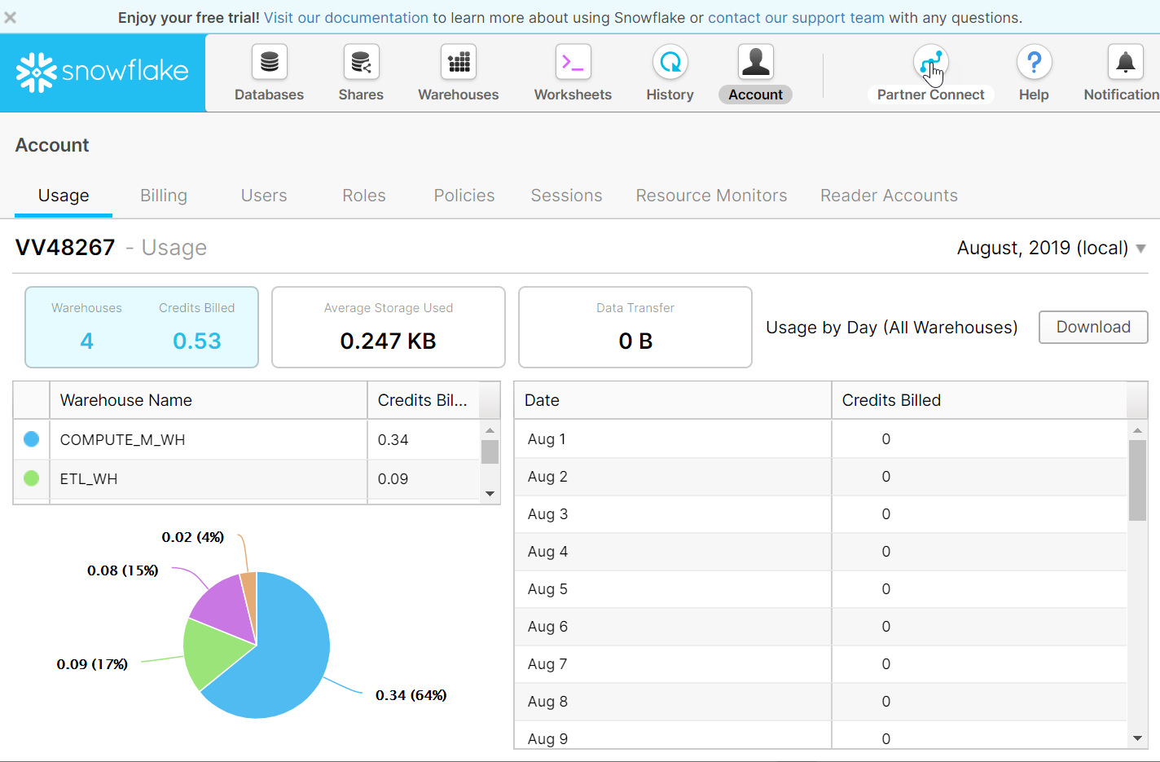
COST MANAGEMENT
Web UI – Account
Use ACCOUNTADMIN role
Resource Monitors
Quotas
Schedules
Levels of monitoring
Views in SNOWFLAKE database
ACCOUNT_USAGE.WAREHOUSE_METERING_HISTORY
ACCOUNT_USAGE.STORAGE_USAGE

Slide 30
DEMO 05
Cost Management

Slide 31
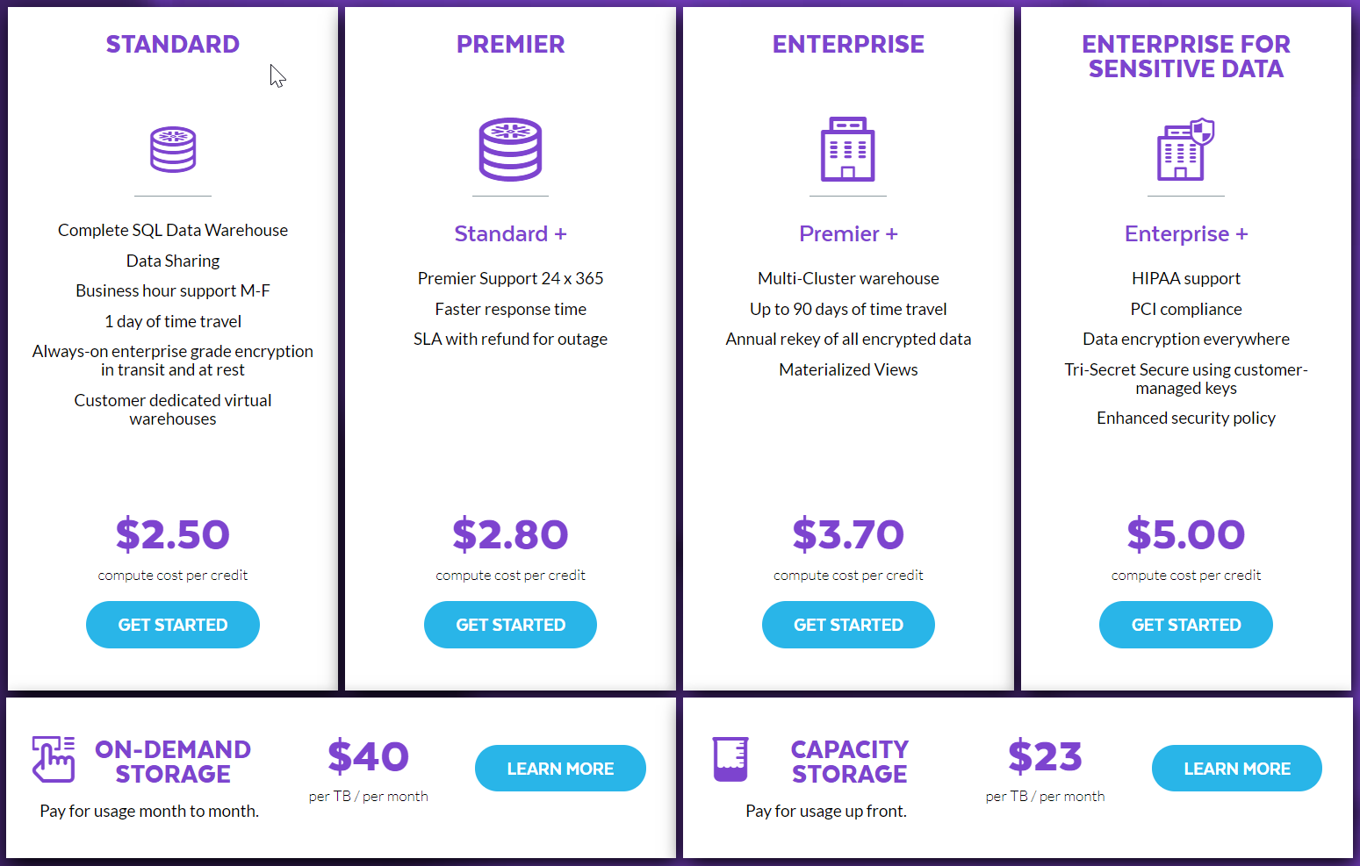
EDITIONS & PRICING
4 editions on Azure
On AWS also VPS
Quickly expanding
East US 2
US Gov Virginia
Canada Central
West Europe
Australia East
Southeast Asia ^{NEW}
https://www.snowflake.com/pricing/

Slide 32
HOW TO LEARN SNOWFLAKE
Start Free Trial
https://trial.snowflake.com/
Run hands-on lab
https://s3.amazonaws.com/snowflake-workshop-lab/Snowflake_free_trial_LabGuide.pdf
Snowflake’s Youtube Channel
https://www.youtube.com/user/snowflakecomputing/playlists
Snowflake’s Blog
https://www.snowflake.com/blog/
Tutorials, Videos & Other Resources
https://docs.snowflake.net/manuals/other-resources.html

Slide 33

Dziękuję!
pawel.potasinski@elitmind.com
tomasz.mazurek@snowflake.com

Slide 34


PASS SUMMIT / 24 HOURS OF PASS
https://www.pass.org/24hours/2019/summitpreview/About.aspx
https://www.pass.org/summit/2019/Home.aspx

